Slide 1

Video Game Sales
By Christian C, Jordan H, Brendan V.
Team BiBimbap

Slide 2
Dataset Description
Dataset: 🎮 EDA - VIDEO GAME SALES
https://www.kaggle.com/code/upadorprofzs/eda-video-game-sales/input
VG Chartz:https://www.vgchartz.com/
Data: Includes game sales from NA, EU, JP
Do we think the data is reliable?
Constantly updating
Credible sources.
Licensed under Apache License, Version 2.0

Slide 3
5 Questions
Which 5 years got the most global sales?
Which 10 Publishers had the most global sales in 2010?
What game had the highest sales in Japan?
What is the most sold game in Europe?
Which region had highest sales from the game Pokemon red/Pokemon blue?

Slide 4
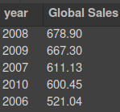
SQL
SELECT
year,
SUM(global_sales) AS 'Global Sales Per Year'
FROM vgsales
GROUP BY year
ORDER BY `Global Sales Per Year` DESC
LIMIT 5;
Which 5 years got the most global sales?

Slide 5
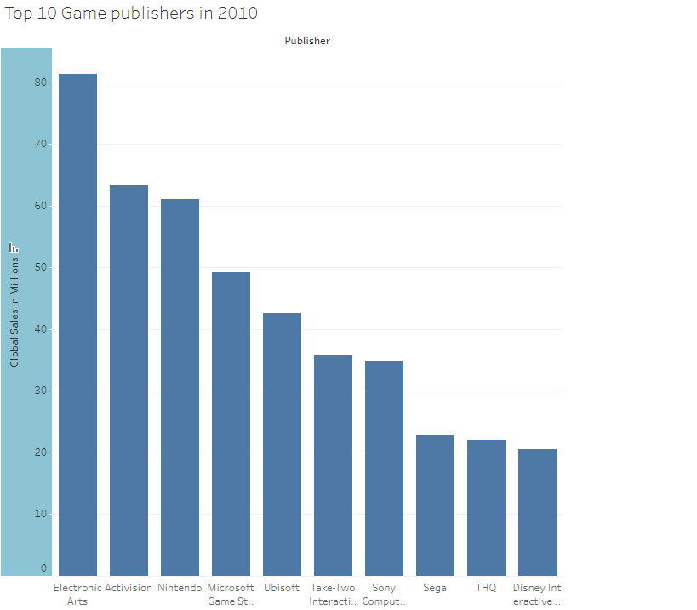
Data visualization
Which 10 Publishers had the most global sales in 2010?
Electronics arts had the most sales, Genre: Sports
Disney Interactive studio had the least sales Genre: RPG
Made in tableau

Slide 6
SQL
SELECT game_title, EU_sales FROM vgsales
ORDER BY EU_sales DESC
LIMIT 1
Wii Sports is the most sold game in Europe with 29 million sales
What is the most sold game in Europe?

Slide 7

SQL
SELECT Name, JP_Sales
FROM `vgsales-415622.vgsales.video_game_sales`
order by JP_Sales desc
Limit 1
About 10.22 million sales in Japan
What game had the highest sales in Japan?

Slide 8
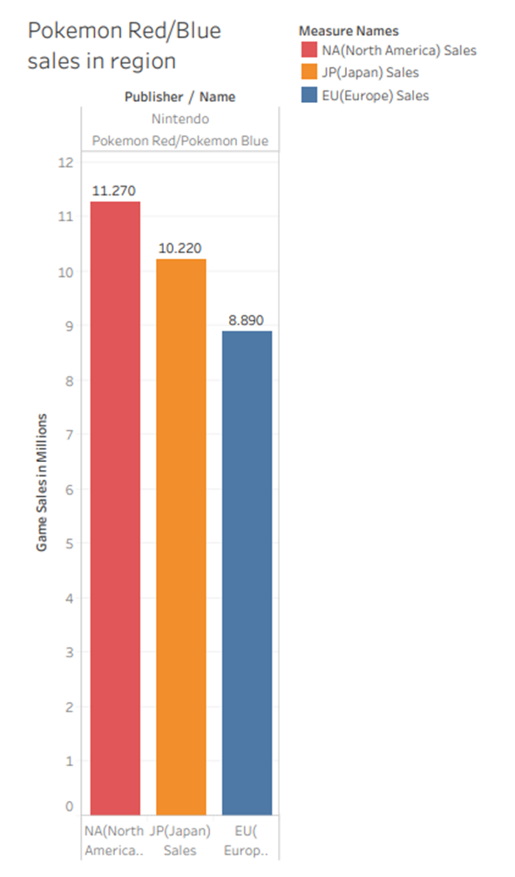
Data visualization
Which region had best sales from the game Pokemon Red/Pokemon Blue?
NA had the most sales 11.27 million
JP in the middle with 10.22 million
EU had the least 8.89 million
Made in Tableau

Slide 9
Data cleaning
Cleaned N/A, Nulls
Renamed platforms
Changed headers for data visualizations
Fixed spelling mistakes

Slide 10
Conclusion
Pokemon red/blue
North America had the most sales because of the popularity of the game boy.
Wii
Nintendo was the most popular publisher in North America and Europe because of the wii.
Final thoughts
In the end we found sales in video games varied depending on many different factors. The main ones being regions, access, genre.
1

Slide 11
References
https://www.kaggle.com/code/upadorprofzs/eda-video-game-sales/input
https://www.vgchartz.com/

